Slide 1
Gyroscope on Robot
Samuel Lee, Christopher

Slide 2
4/7/23

Slide 3
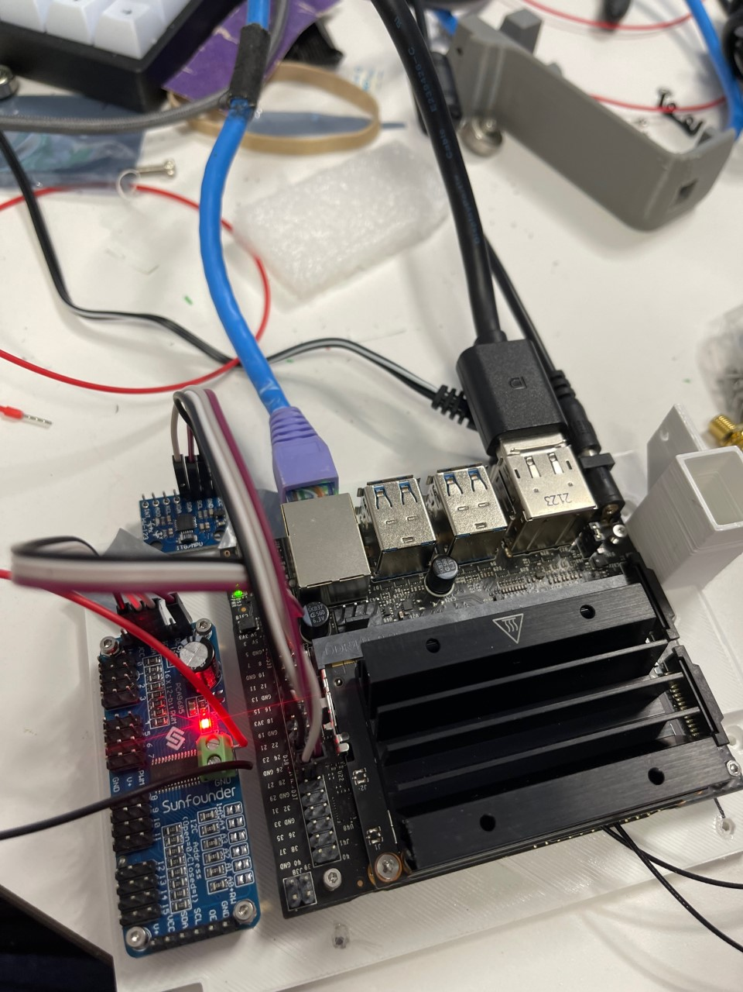
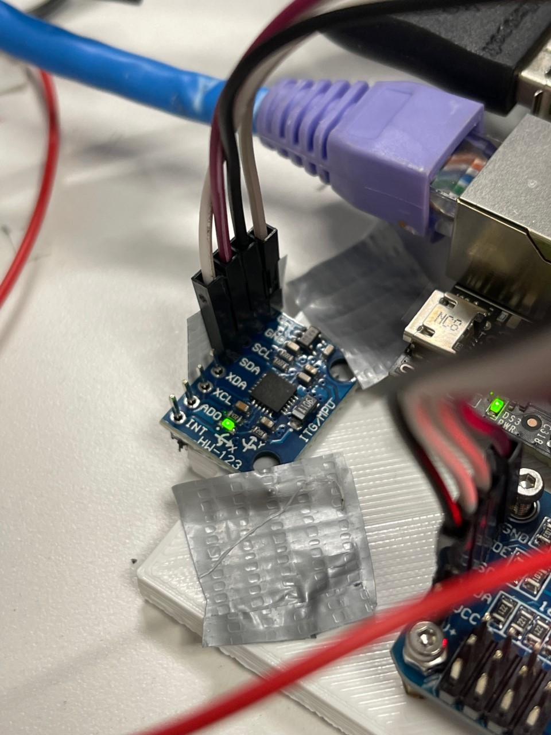
Physical component

Slide 4
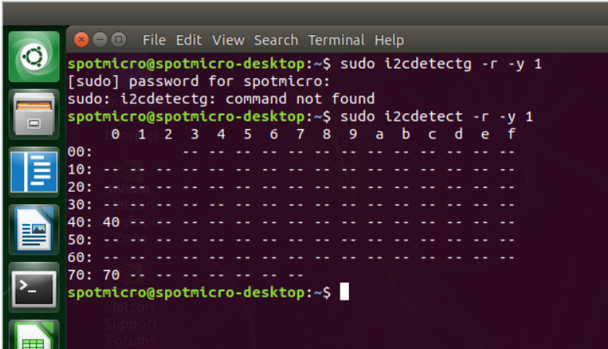
Need more SDA/SCL pins (previously sunfounder)

Slide 5
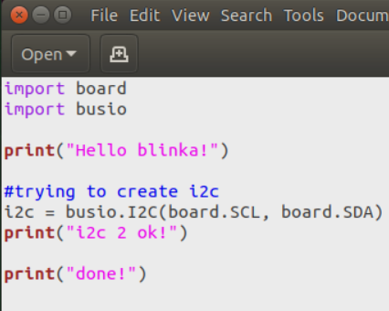
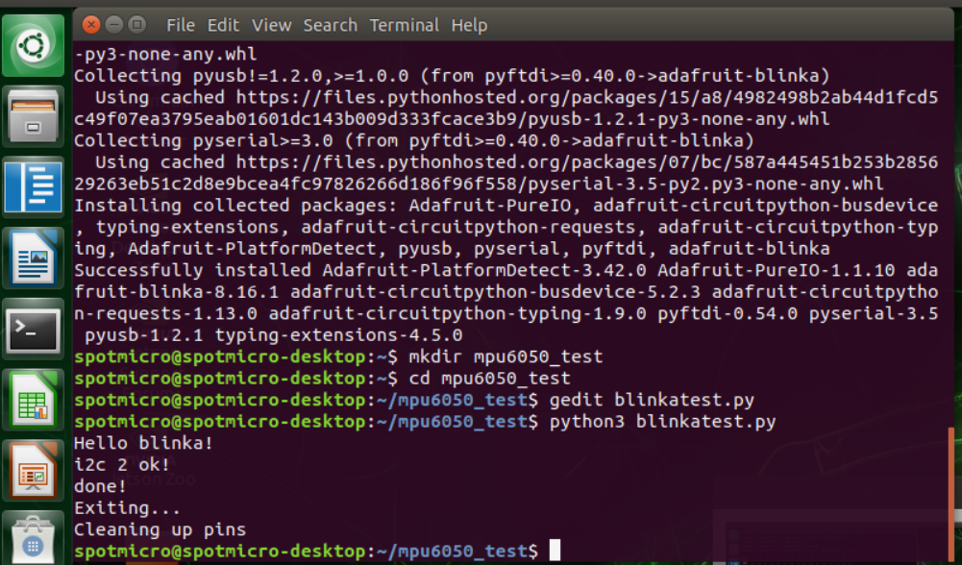
Test adafruit blinka repository (code source in final slide)

Slide 6
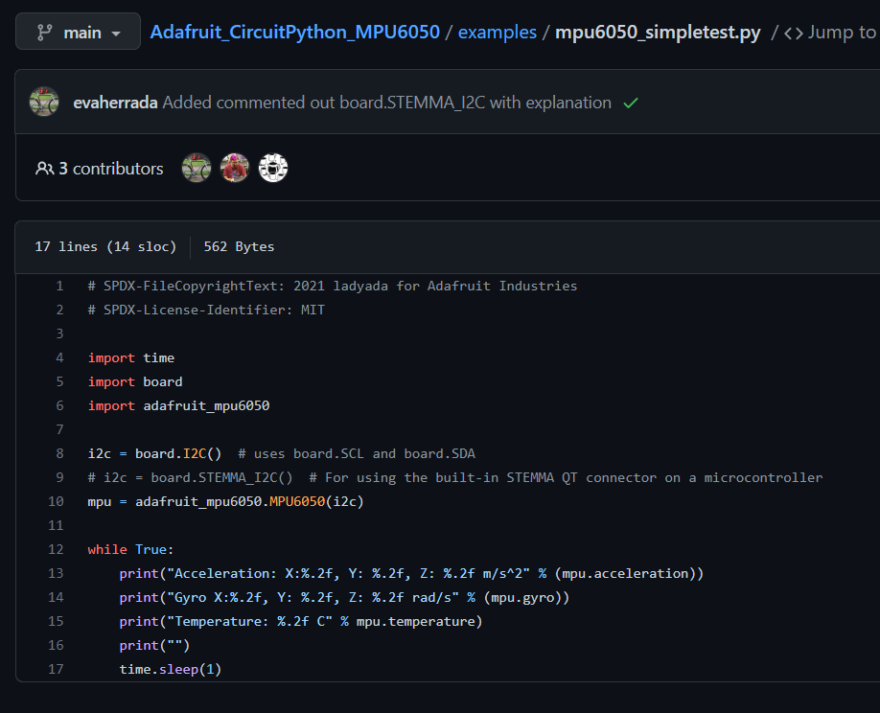
Second test program - temperature, acceleration, etc

Slide 7
tried:
python3 mpu6050_simpletest.py
Traceback (most recent call last):
File "mpu6050_simpletest.py", line 10, in <module>
mpu = adafruit_mpu6050.MPU6050(i2c)
File "/home/spotmicro/.local/lib/python3.8/site-packages/adafruit_mpu6050.py", line 205, in __init__
self.i2c_device = i2c_device.I2CDevice(i2c_bus, address)
File "/home/spotmicro/.local/lib/python3.8/site-packages/adafruit_bus_device/i2c_device.py", line 63, in __init__
self.__probe_for_device()
File "/home/spotmicro/.local/lib/python3.8/site-packages/adafruit_bus_device/i2c_device.py", line 185, in __probe_for_device
raise ValueError("No I2C device at address: 0x%x" % self.device_address)
ValueError: No I2C device at address: 0x68

Slide 8
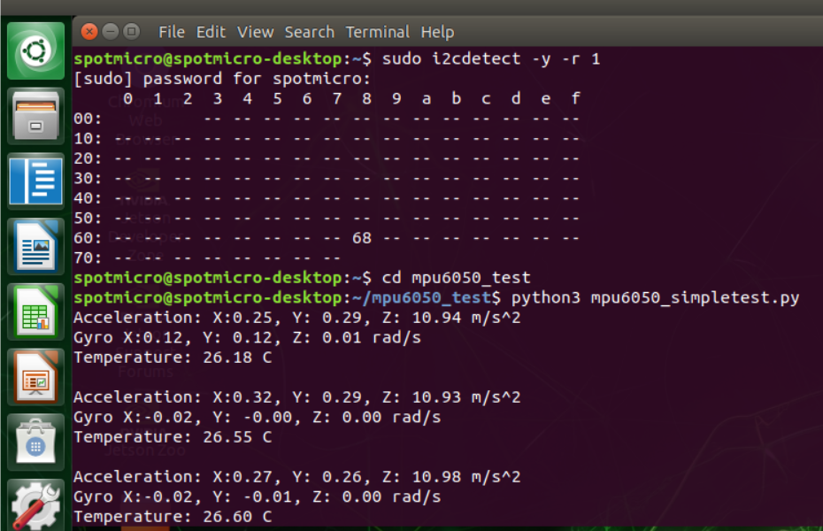
success

Slide 9
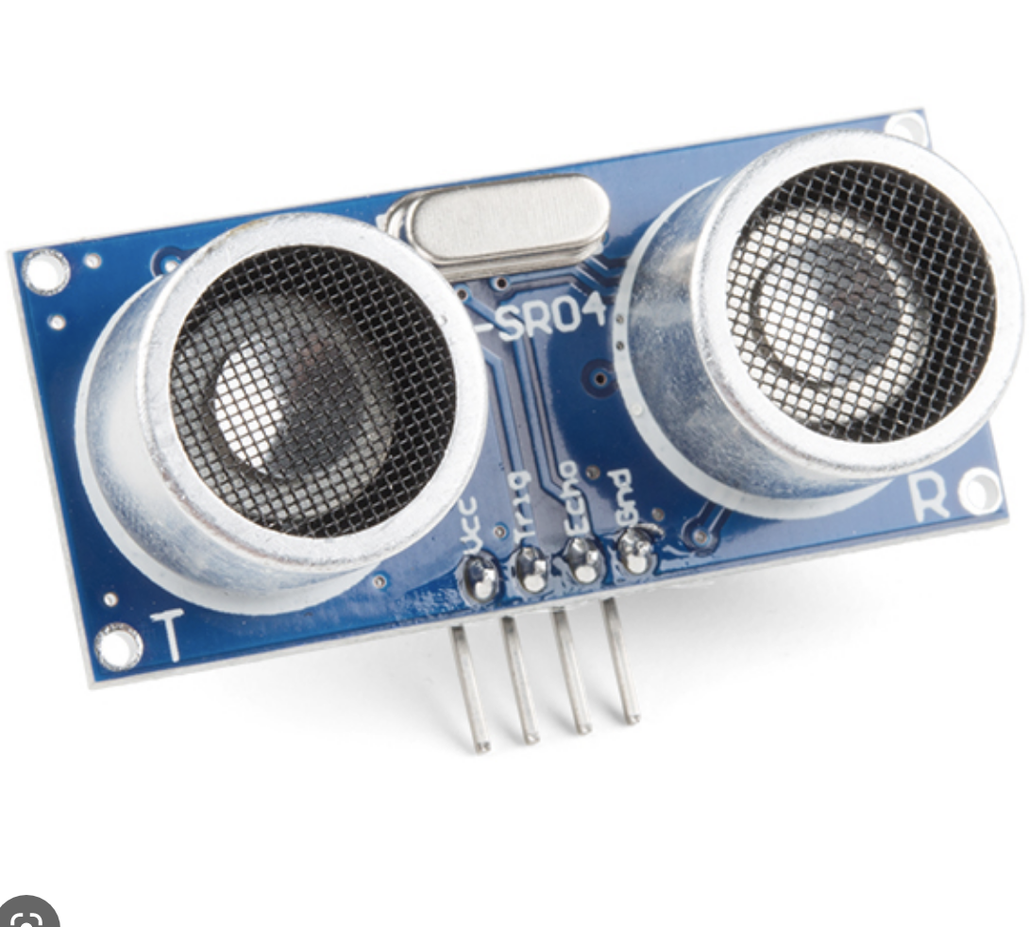
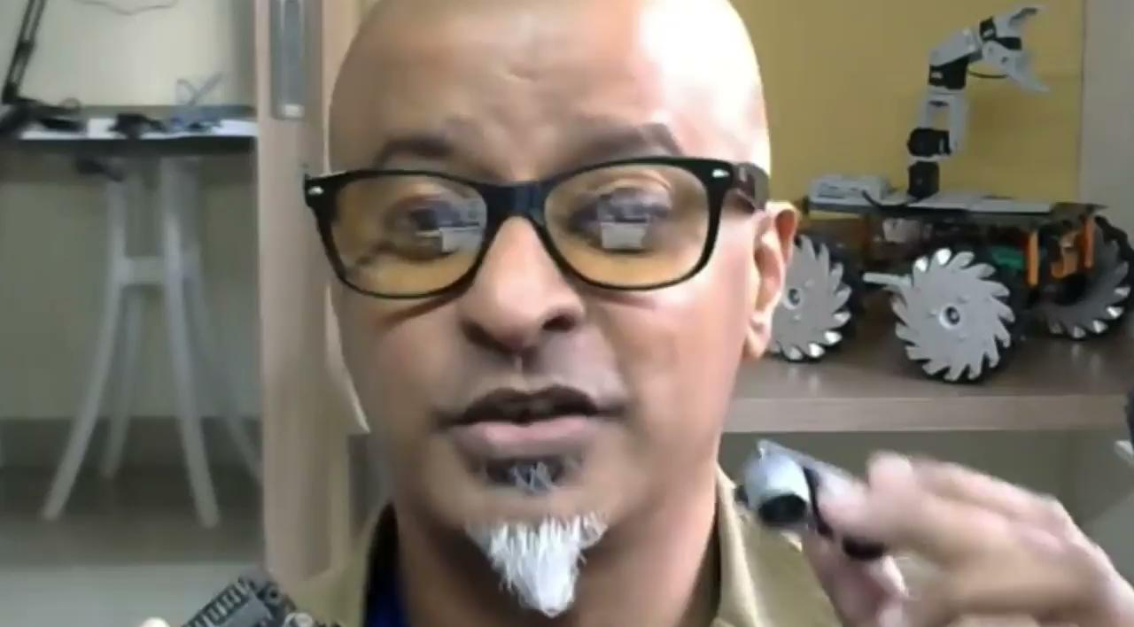
Attempt to Connect to HC-SR04
Need parts to safely add ultrasonic sensor.
Regardless, have added ROS to Jetson Nano to get data from sensors and move servos with it

Slide 10
4/14/23

Slide 11
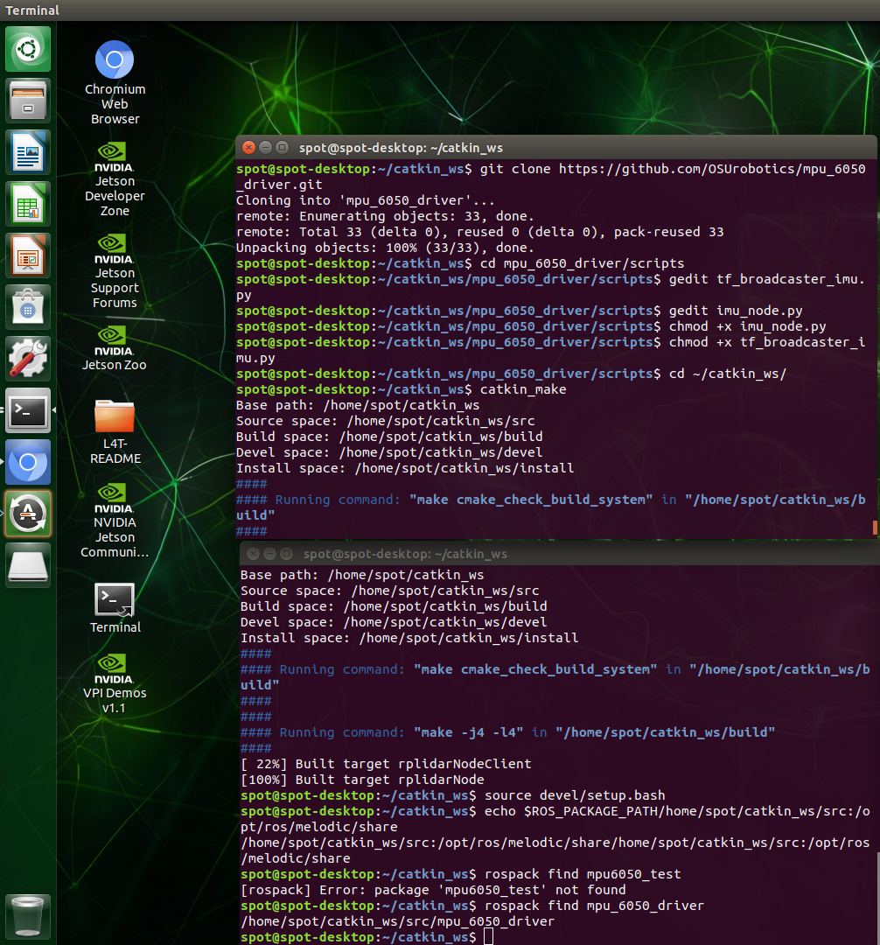

Slide 12
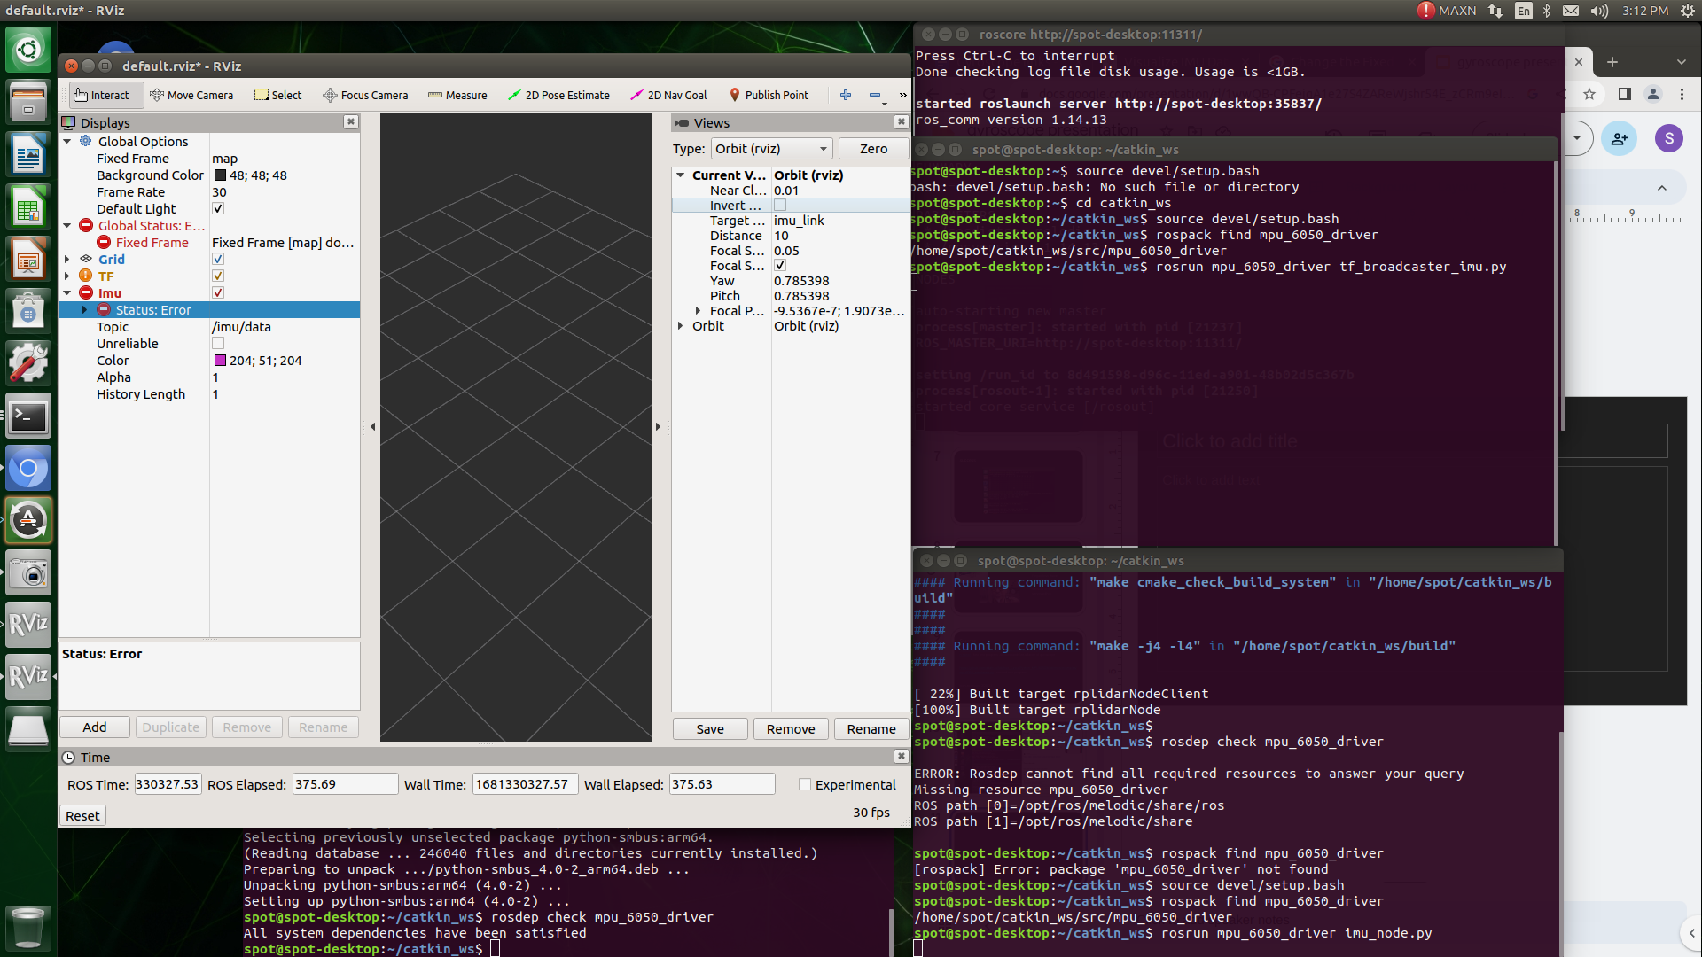

Slide 13
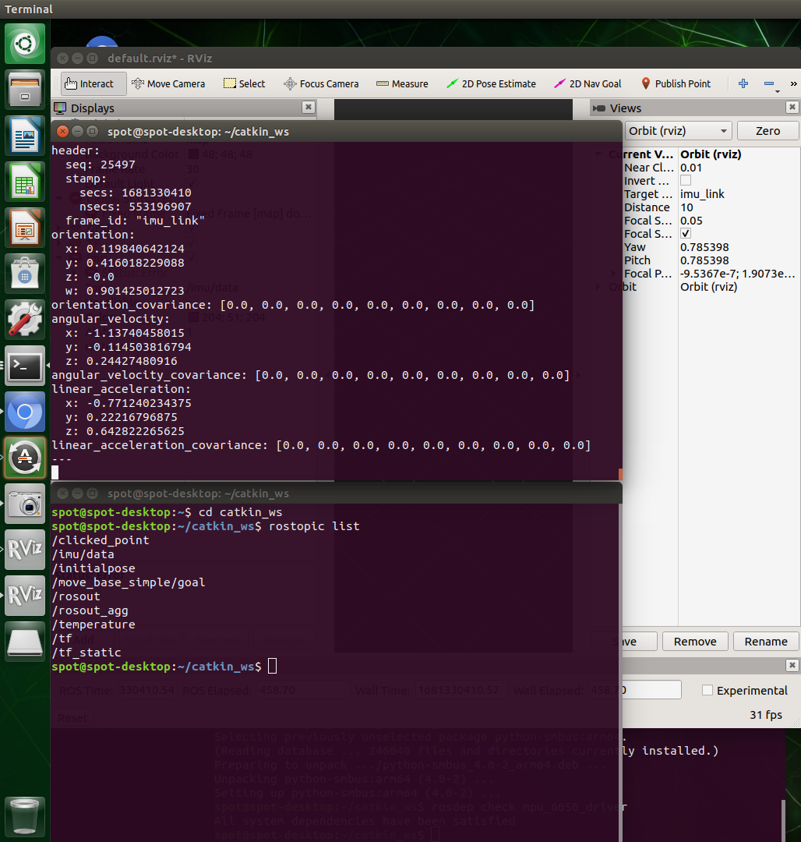

Slide 14


